Slide 1


Epic, Feature, and Story

Slide 2
Product Backlog Items: Epics
An Epic is a container for a significant Solution development initiative that captures the more substantial investments that occur within a portfolio. Due to their considerable scope and impact, epics require the definition of a Minimum Viable Product (MVP).
Some of the epics are cross-cutting, typically spanning multiple value streams. It is recommended to apply the Lean Startup build-measure-learn cycle for epics to accelerate the learning and development process, and to reduce risk. Epics are delivered over a multiple set of sprints and/or multiple teams.
Generally, epics often change in scope over time as a natural aspect of agile way of development.
There are two types of epics — Business and Enabler epics. Business epics directly deliver business value, while Enabler epics are used to advance the Architectural Runway to support upcoming business or technical needs.
Epic
Feature
User Story

Slide 3
Epic Hypothesis Statement
Funnel Entry Date | <The date that the Epic entered the funnel>
Epic Name | <A short name for the Epic>
Epic Owner | <The name of the Epic owner>
Epic Description | <An elevator pitch (value statement) that describes the Epic in a clear and concise way> For <customers> who <do something> the <solution> is a <something – the ‘how’> that <provides this value> unlike <competitor, current solution or non-existing solution> our solution <does something better — the ‘why’>
Business Outcomes | <The measurable benefits that the business can anticipate if the Epic hypothesis is proven to be correct>
Leading Indicators | <The early measures that will help predict the business outcome hypothesis>
Nonfunctional Requirements (NFRs) | <Nonfunctional requirements (NFRs) associated with the Epic>

Slide 4
Product Backlog Items: Features
Epic
Features are visible ‘units’ of business intent that the customer recognizes, and it’s at this level of detail that the customer is able to prioritize their needs.
An Epic contains one or more Features.
Features may span multiple user roles, stories and use cases. Multiple teams may work on the same feature, swarming together to deliver them quickly.
Although features may take multiple Sprints to develop, they should be easily completed within a couple of Sprints.
Each feature includes a Benefits Hypothesis and a set of Acceptance Criteria.
Features are realized by a collection of user stories.
Feature
User Story

Slide 5
Features and Benefits (FAB) Matrix
Funnel Entry Date | <The date that the Feature entered the funnel>
Feature Name | <A short name for the Feature>
Feature Owner | <The name of the Feature owner>
Feature Description | <A short description and context>
Benefit Hypothesis | <The proposed measurable benefit to the end-user or business>
Acceptance Criteria | <A set of predefined requirements that must be met in order to mark this Feature complete>

Slide 6
Product Backlog Items: User Stories
Epic
USER STORIES
User stories are smallest unit of requirements.
They are a concise, written description of a piece of functionality that will be valuable to a user of the product.
User stories are not detailed requirements.
User Stories committed to for a sprint should be completed within a sprint.
Feature
User Story
Notes:
A story or user story is the smallest unit of work in an agile framework. It is a software system requirement that is expressed in a few short sentences, ideally using non-technical language.
The goal of a user story is to deliver a particular value back to the customer. Note that "customers" don't have to be external end users in the traditional sense, they can also be internal customers or colleagues within your organization who depend on your team.
User stories are a few sentences in simple language that outline the desired outcome. They don't go into detailed requirements.
Page #: 7 (a)
Animation/ Interactivity Notes:
Onstage text and graphic with A1
Highlight feature during A2
Highlight User story during A3
Fade in instruction with A4
Only Feature and User Story should be clickable.
Voice Over Script:
Features are derived from Capabilities. Similar to capabilities, features are shippable market solutions or products. Feature exists within a Scrum Team and must be completed within a Program Increment.

Slide 7
Product Backlog Items: User Stories
User stories are short, simple descriptions of a feature told from the perspective of the person who desires the new capability, usually a user or customer of the system.
User stories should be concise enough that they could fit on one index card or sticky note, then arranged on walls or tables to facilitate planning and discussion.
As such, they strongly shift the focus from documentation (writing about features) to discussing them.

Slide 8
User Story – Most Popular Format
As a < role>, I want < goal > so that < benefit>
The above format guides the teams to understand that currently and in immediate future:
Users of the system;
Usage of the system; and
Purpose of the system.
Applying the ‘user voice’ format routinely tends to increase the team’s domain competence; they come to better understand the real business needs of their user.
A user can be a person or a machine – device, equipment, software, etc.

Slide 9
User Story – Other Formats
One which eliminates the cause
As a <role>, I want <goal/desire>
One which emphasize the benefit
In order to <receive benefit> as a <role>, I want <goal/desire>
Based on the Five Ws
As <who> <when> <where>, I <what> because <why>
Now emphasis is on capability
As a <role>, I can <action with system> so that <external benefit>
Focus is on persona and “WHY”
As <persona>, I want <what?> so that <why?>
Focus is on “WHY” and “conditions”
When <situation>, I want to <motivations & forces>, so I can <expected output>
Ref: https://github.com/tusjain/agileanswer/blob/master/repository/User%20Story%20Format.pdf

Slide 10
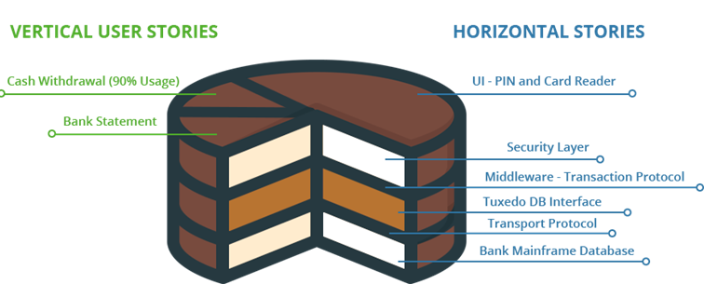
Vertical vs. Horizontal User Stories
A story needs to be valuable; it needs to be valuable to the customer. Developers may have (legitimate) concerns, but these framed in a way that makes the customer perceive them as important.
Think of a whole story as a multi-layer cake, e.g., a network layer, a persistence layer, a logic layer, and a presentation layer. When we split a story, we're serving up only part of that cake. We want to give the customer the essence of the whole cake, and the best way is to slice vertically through the layers. Developers often have an inclination to work on only one layer at a time (and get it "right"); but a full database layer (for example) has little value to the customer if there's no presentation layer.

Slide 11
User Stories - Components
A good user story has three components, commonly referred to as the three C’s.
Card
Conversation
3 C’s
Confirmation

Slide 12
User Stories - Components
CARD
A user story should be short enough to fit on a note card or Post-it when written physically.
The information included in the card should identify and plan the requirement.
Card
Conversation
3 C’s
Confirmation

Slide 13
User Stories - Components
CONVERSATION
Conversation is critical throughout the software development lifecycle. Conversations represent discussions between the Product Owner, development teams and the stakeholders.
Card
Conversation
3 C’s
Confirmation

Slide 14
User Stories - Components
Card
Conversation
3 C’s
CONFIRMATION
Acceptance criteria should be defined before a user story is developed. Confirmation helps in delivering successful user stories with reduced rework and incorrect assumptions.
Confirmation

Slide 15
INVEST in User Stories
I
N
V
E
S
T

Slide 16
INVEST in User Stories
The acronym INVEST helps to remember a widely accepted set of criteria, or checklist, to assess the quality of a user story. If the story fails to meet one of these criteria, the team may want to reword it, or even consider a rewrite (which often translates into physically tearing up the old story card and writing a new one). A good user story should be:
Independent
Negotiable
Valuable
Estimable
Small
Testable
I
N
V
E
S
T

Slide 17

INVEST in User Stories
Independent
Negotiable
Valuable
Estimable
Small
Testable
I
N
V
E
S
T
E
Make stories as independent as possible from each other.

Slide 18

INVEST in User Stories
Independent
Negotiable
Valuable
Estimable
Small
Testable
I
N
V
E
S
T
Start with a brief description. Details emerge in discussion

Slide 19

INVEST in User Stories
Independent
Negotiable
Valuable
Estimable
Small
Testable
I
N
V
E
S
T
Users and customers perceive value in the deliverables

Slide 20

INVEST in User Stories
Independent
Negotiable
Valuable
Estimable
Small
Testable
I
N
V
E
S
T
Domain and technical knowledge allow the team to provide estimates

Slide 21

INVEST in User Stories
Independent
Negotiable
Valuable
Estimable
Small
Testable
I
N
V
E
S
T
A team can finish one story in a few days, and several in every sprint

Slide 22

INVEST in User Stories
Independent
Negotiable
Valuable
Estimable
Small
Testable
I
N
V
E
S
T
Validation criteria and techniques are specified clearly

Slide 23
User Story Acceptance Criteria
Acceptance Criteria are the list of functional and non-functional requirements that a software product must satisfy in order to be accepted by the stakeholders.
Given: a scenario
When: an action is carried out
Then: a particular set of observable results should be displayed
Example
Given that I am a paid Netflix subscriber, I want the ability to manage parental controls. When there is an attempt to access the channels that I have locked, then a warning message should be displayed and the channel should not be accessed unless a correct password is entered.

Slide 24
User Stories: Definition of Ready
Teams can check the quality of the user stories using a Definition of Ready. Getting started on a sprint with poorly understood stories can result in rework or could take the team in the completely wrong direction.
Definition of Ready for a User Story
User Story defined
The expected behavior is understood by relevant team members
The business value is clearly articulated
The story is small enough to fit in one sprint (INVEST)
User story has been estimated/sized by the development team
Scrum Team accepts User Experience artifacts
Performance criteria identified, where appropriate
The story has clear and concise acceptance criteria which covers all of the features of the story
Team has an idea how, and if, it can be demonstrated
Known user Story dependencies identified and captured in the story
No external dependencies block the story being started or completed
Test data needed to test the functionality is identified

Slide 25
User Stories: Definition of Done
The Definition of Done (DoD) is used to describe when a user story from the Sprint Backlog can be considered complete. Definition of Done is a simple checklist of all necessary activities (e.g. writing code, coding comments, unit testing, integration testing, release notes, design documents, etc..) that ensure that only truly completed features are delivered, both in terms of functionality and in terms of quality.
Definition of Done for a User Story
What must happen for the story to be marked as complete. This may vary across team.
May include:
Story should have automated acceptance test
The story should have working code supported by unit test that provide around 60 – 70 percent coverage
The story should have well defined acceptance criteria
The code must have been written as a pair or should be code reviewed
Code must be completely checked in to the source control system and the build should pass with all the automated tests running
The Product Owner must accept the story

Slide 26

Estimation
Ref: https://github.com/tusjain/agileanswer/blob/master/repository/Relative%20Estimation%20of%20Epics%20and%20Features.pdf

Slide 27
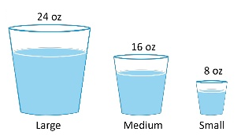
Absolute vs. Relative Estimate
Absolute Estimate: Each item is estimated in isolation without comparing it with other items
Relative Estimate: Items are compared and ordered or assigned an arbitrary number/designation to depict order

Slide 28
Estimating an Story
A story point is a singular number that represents a combination of qualities:
Volume – How much is there?
Complexity – How hard is it?
Knowledge – What’s known?
Uncertainty – What’s unknown?
Story points are relative, without a connection to any specific unit of measure. The size (effort) of each story is estimated relative to the smallest story, which is assigned a size of ‘one.’ A Fibonacci sequence (1, 2, 3, 5, 8, 13, 21, …) is applied that reflects the inherent uncertainty in estimating.
Stories are estimated by DevTeam

Slide 29
Estimating an Story
Use a starting baseline where one story point is defined roughly the same across all teams. This means that work can be prioritized based on converting story points hours. Normalized story points provide a method for getting to an agreed starting baseline for stories:
Give every DevTeam member eight points (adjust for part-timers).
Subtract one point for every team member vacation day and holiday.
Find a small story that would take one day to complete (dev, test, and validate). Assign one Story Point to this Story.
Estimate every other story relative to that ‘one.’
Exercise 1: Pick a story from your work area of size one Story Point and the estimate the size of two other stories.
Exercise 2: Play Planning Poker

Slide 30
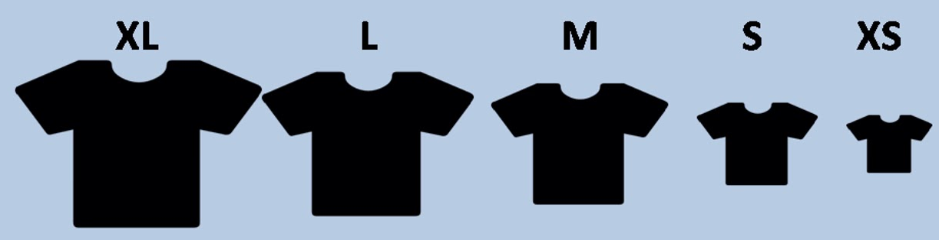
Estimating a Feature
A Feature is estimated using T-shirt sizing
Extra Small (XS)
Small (S)
Medium (M)
Large (L)
Extra Large (XL)

Slide 31
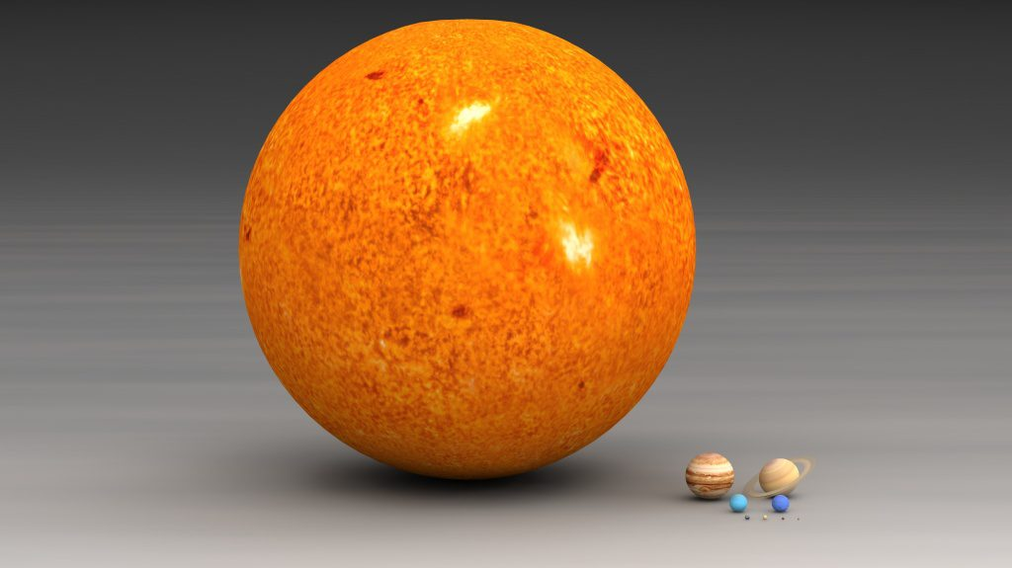
Estimating an Epic
To estimate an Epic use ordering protocol method (arranging big to small in an ordered list)
Enormous
Intermediate
Humble

Slide 32

Decomposition, Slicing,
&
Splitting

Slide 33
Feature Slicing
It is s good practice to have a feature of such a size that it can be DONE in a couple of Sprints. A bigger Feature should be sliced into smaller ones.
Approaches for slicing a Feature are:
Implement Partial Acceptance Criteria
Partial Business Value (use Lean Start up)
Defer Optional Behavior
Separate Different Channels
Address Different User Groups Individually
Incremental Data Sourcing
Isolate Special Variations
Breaking out into Functional and Enablers

Slide 34
Feature Decompose
Teams work on Stories not on Features. Product Owner with help of DevTeam and Product Management decompose Features into byte size Stories.
Approaches for decomposing a Feature are:
Acceptance Criteria based approach
Workflow Steps based approach
Dependencies based approach

Slide 35
Story Split
Smaller stories allow faster, more reliable implementation.
Small stories go through the system faster, reducing variability and risk.
Let’s start from the very beginning:
Test your story on the INVEST model criterion.
If Sprint or Kanban flow is in motion, ensure that the story size is approximately 1/10 to 1/6 of average velocity of your team. These numbers are not hard-set but more of a guideline.
There are four approaches, you can use to split a story:
Grammar approach
Business approach
Technology approach
Miscellaneous
Ref: http://agileanswer.blogspot.com/2016/04/story-splitting-part-1-i-am-sure-youve.html

